Slide 1

Finance Project
written by:
Maayan Bitan
Notes:
<number>

Slide 2
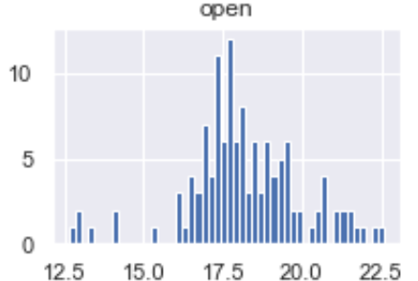
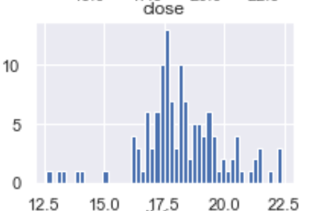
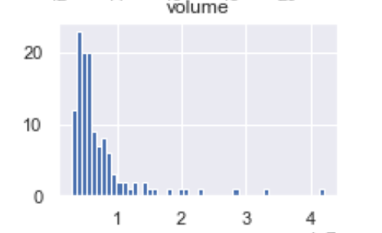


So what does my research actually do?
Can we predict when and how much a stock will rise or fall?
How can we predict and what conclusions can be drawn from an increase or decline in a stock?
Which model is suitable for the requested prediction and what is the percentage of error?
Notes:
<number>

Slide 3
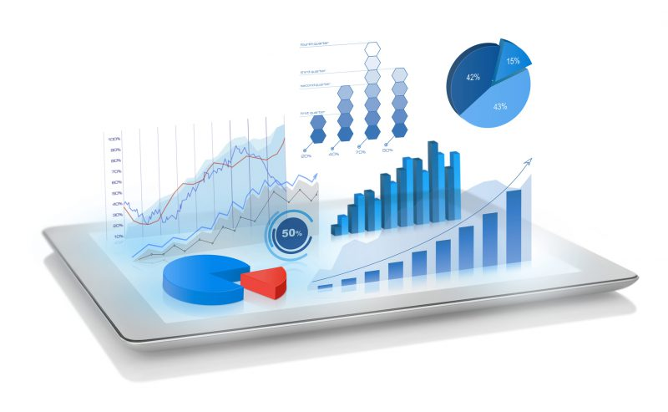
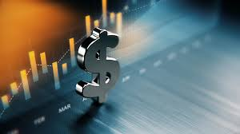

Data sources
API:
Yahoo Finance
Notes:
<number>

Slide 4



Yahoo Finance - API
I used Yahoo Finance's built-in API.
I wrote a script that runs everything
Over the DB and retrieve all records by dates
Finally I chained to 'df api' a data frame
Notes:
<number>

Slide 5

Data cleaning
Threading of all the information to one table.
Filter unwanted values (incorrect values).
Outline handling.
Notes:
<number>

Slide 6
Data cleaning
Arranging the format of the dates.
Delete duplicates if and exist
Notes:
<number>

Slide 7
ML - machine learning
I used 4 models with 10,0000 data to predict the increase.
It is now possible to see which model is more predictable.
I returned the errors of each of the models.
Notes:
<number>

Slide 8
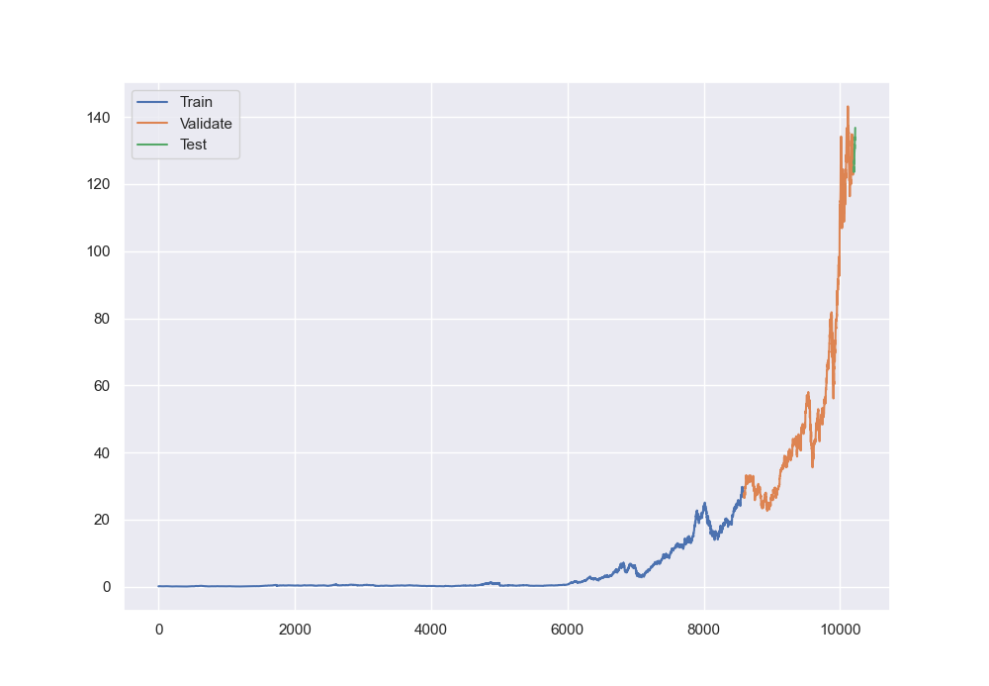
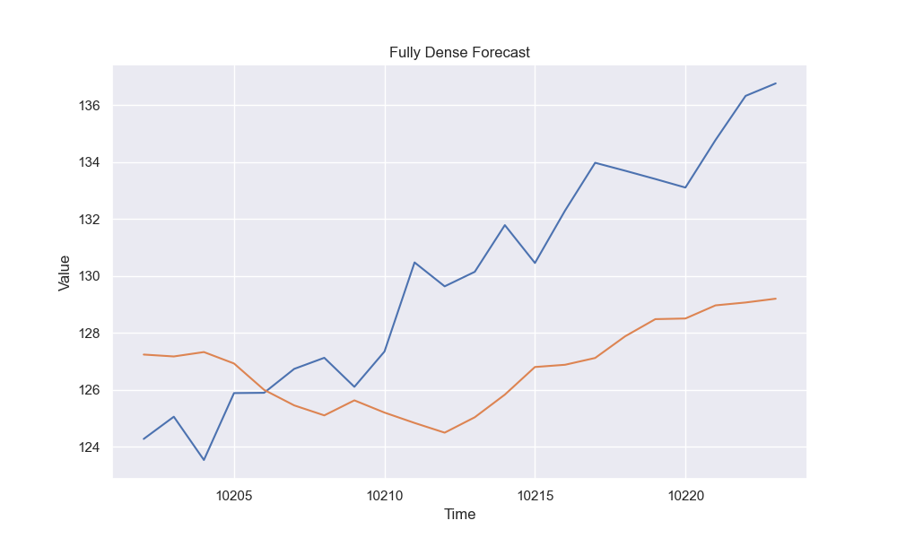
Dense model
Notes:
<number>

Slide 9
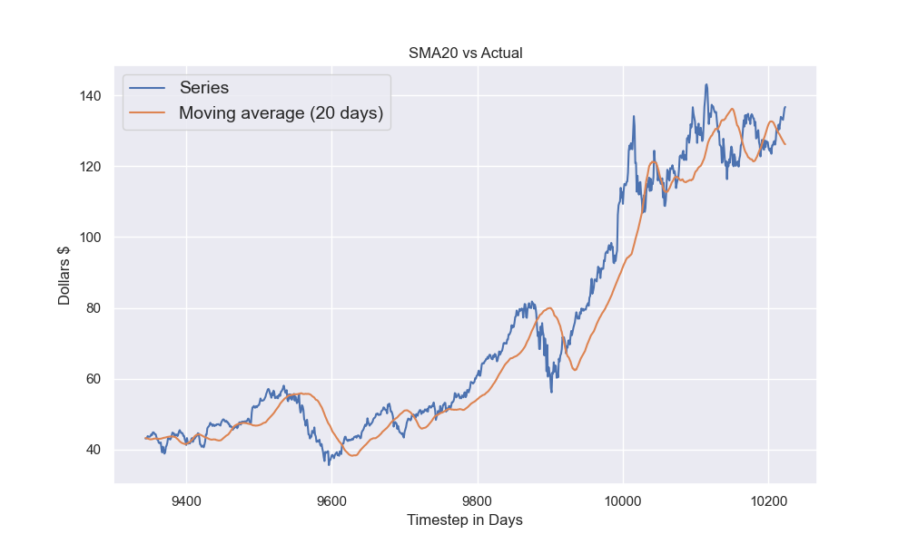
MA(20) – Moving average model
Notes:
<number>

Slide 10
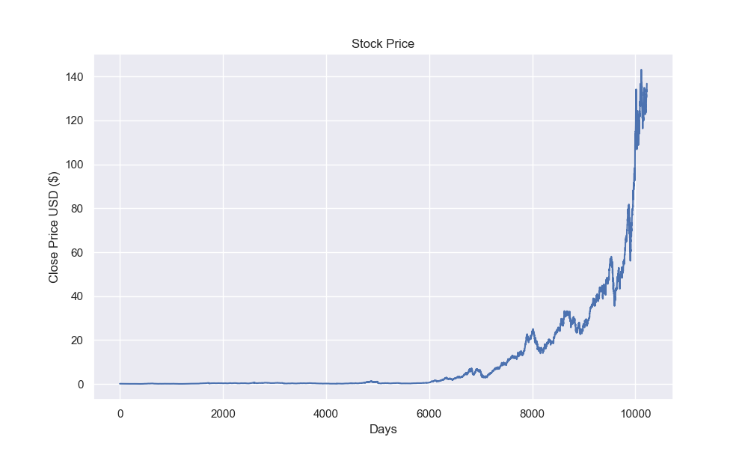
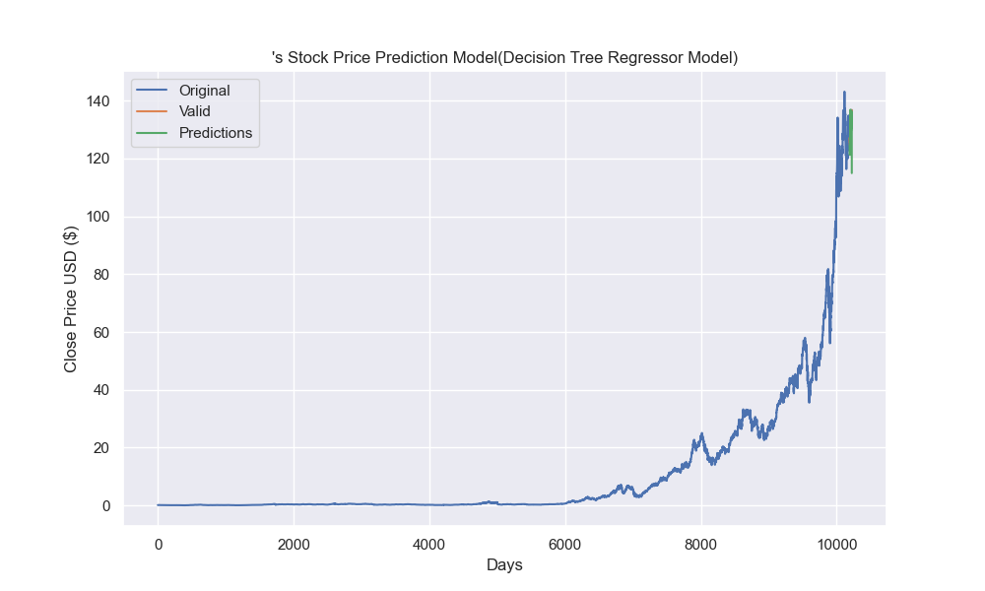
Decision tree
Notes:
<number>

Slide 11
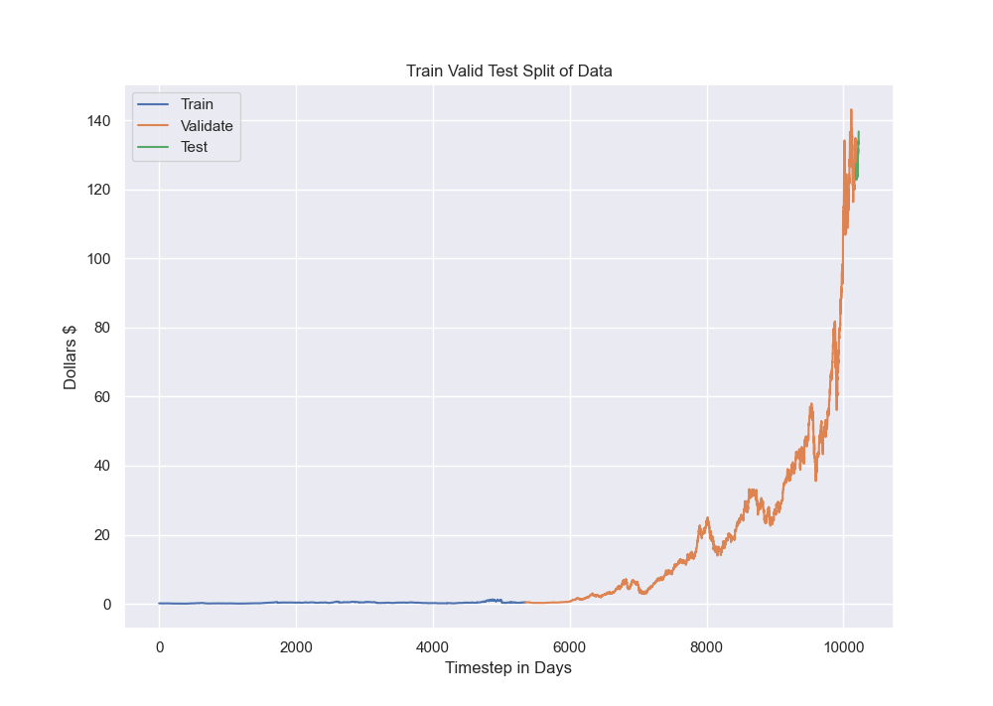
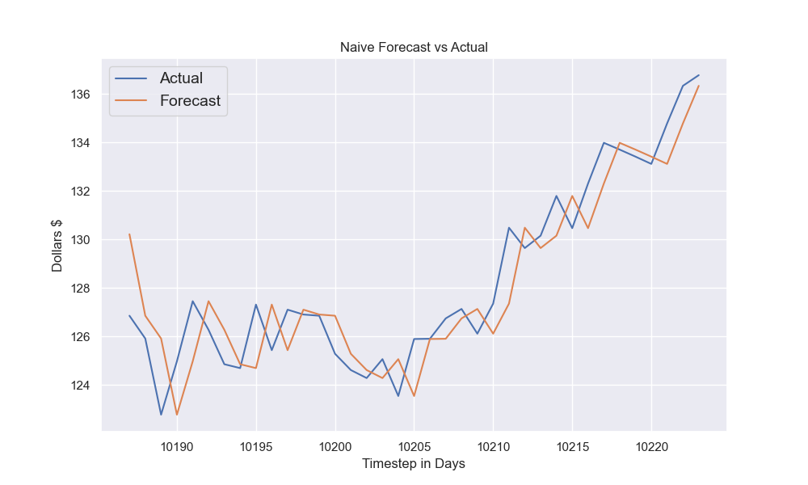
Naive model
Notes:
<number>

Slide 12
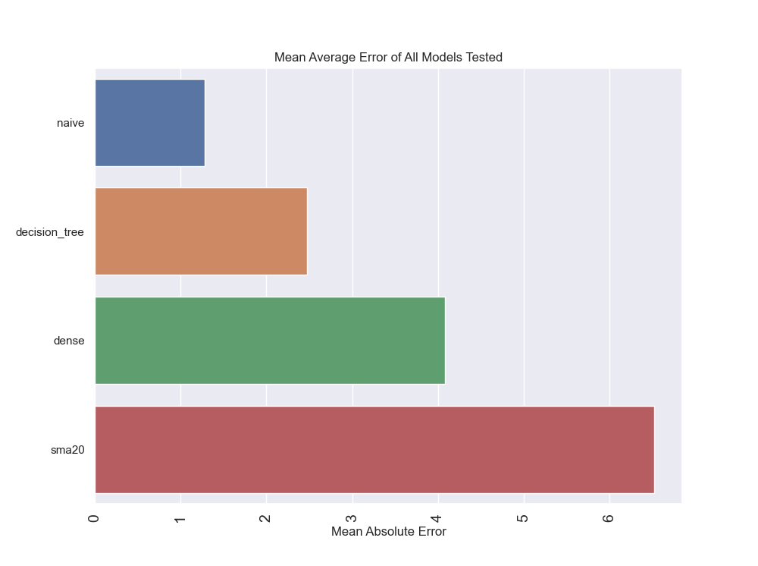
Average error models tested

